Slide 1


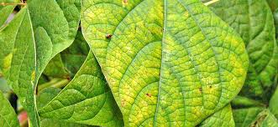


DEEP LEARNING Project
IDENTIFICATION OF PLANTS NUTRIENT DEFICIENCIES
Section 25 Batch - 2

Slide 2
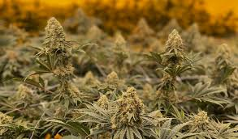
TEAM DETAILS
2100090151 - Durga Sai Deepak . Y
2100039130 - Bharath Kumar . V
2100080125 - Santhosh Kumar . M
2100031270 - Lokesh Satya . J
2100031530 - Koushik .B

Slide 3
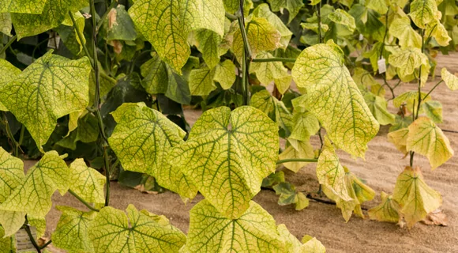
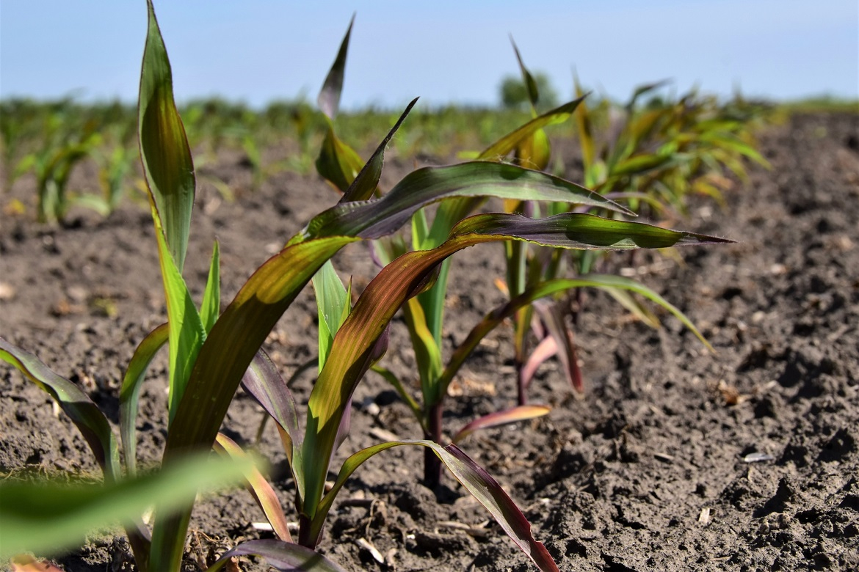

INTRODUCTION
Plants stand as the silent architects of our ecosystem, providing oxygen, sustenance, and shelter for an array of organisms, including humans. Their role in maintaining ecological balance and supporting life on Earth cannot be overstated. However, despite their resilience, plants, like all living organisms, are susceptible to various stressors, including nutrient deficiencies.
Plants and Their Vital Role: Plants serve as the cornerstone of terrestrial life, serving as primary producers in food chains, purifying the air we breathe, and contributing to the overall health of our planet's ecosystems. Their ability to harness sunlight and convert it into energy through photosynthesis is fundamental to sustaining life on Earth.

Slide 4
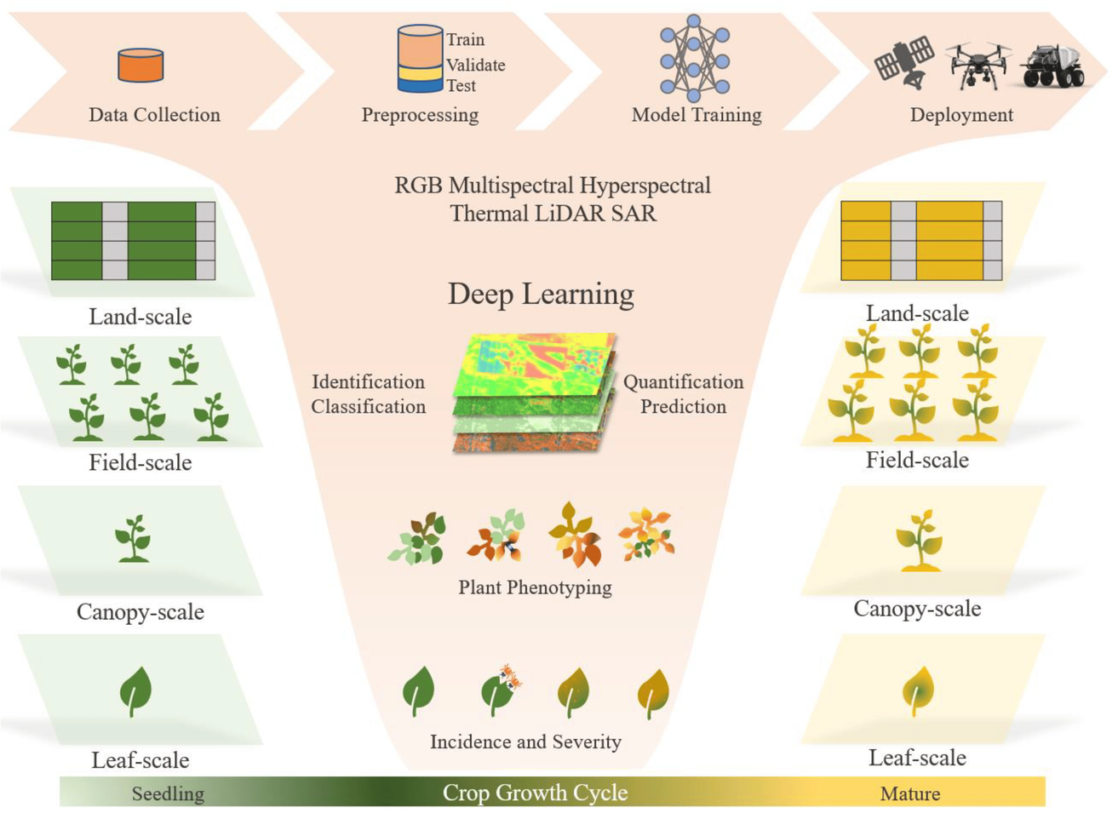
Project Objective
The primary goal of this project is to develop an advanced plant disease classifier equipped with the capability to precisely identify and diagnose nutrient deficiencies in plants. Through the utilization of cutting-edge machine learning techniques, particularly deep learning, we aim to create a robust model that can analyze images of plant leaves and accurately determine the presence of nutrient deficiencies. By achieving this objective, we aspire to provide farmers and agricultural stakeholders with a powerful tool for early detection and effective management of nutrient deficiencies in crops. Ultimately, our aim is to contribute to the optimization of agricultural practices, enhance crop yield, and promote sustainable food production.

Slide 5

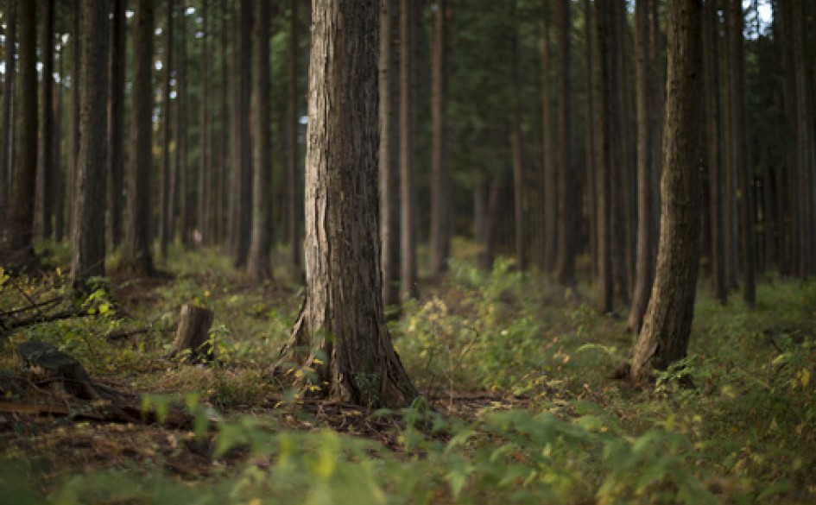
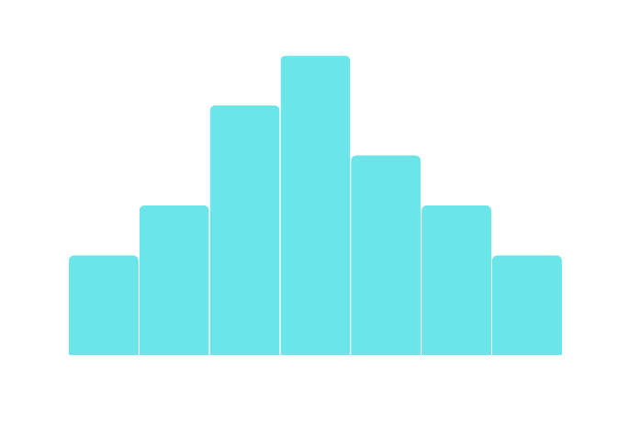
DATASET DESCRIPTION:
Training Set
This subset constitutes a vast array of images meticulously curated for training the plant disease classifier. Through exposure to a diverse range of images, the model can learn to discern intricate patterns and features indicative of nutrient deficiencies in plants.
Validation Set
Comprising a subset of images distinct from the training set, this dataset serves as a critical component in the model development process. By evaluating the model's performance on unseen data from the validation set, we can gauge its generalization ability and fine-tune parameters to optimize performance.
The cornerstone of our project lies in the utilization of the comprehensive "New Plant Diseases Dataset." This rich dataset comprises a diverse collection of images depicting both diseased and healthy plant leaves across various species and growth stages. Notably, the dataset has been meticulously augmented to encompass a wide range of scenarios representing nutrient deficiency and disease conditions prevalent in real-world agricultural settings. It encompasses three distinct subsets, each serving a specific purpose in the development and evaluation of our model.
Test Set
The test set represents an independent subset of images reserved exclusively for evaluating the final performance of the trained model. By subjecting the model to this unseen data, we can objectively assess its accuracy, precision, recall, and other performance metrics, thereby validating its efficacy in real-world scenarios.

Slide 6
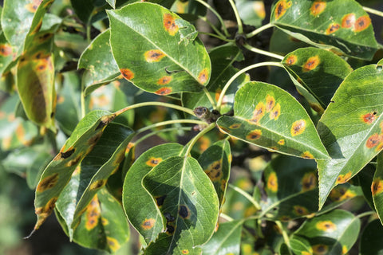


METHODOLOGY
01
02
03
04
Dataset
Description
Data
preprocessing
Implementation of
Models
Model Training and
Evaluation

Slide 7
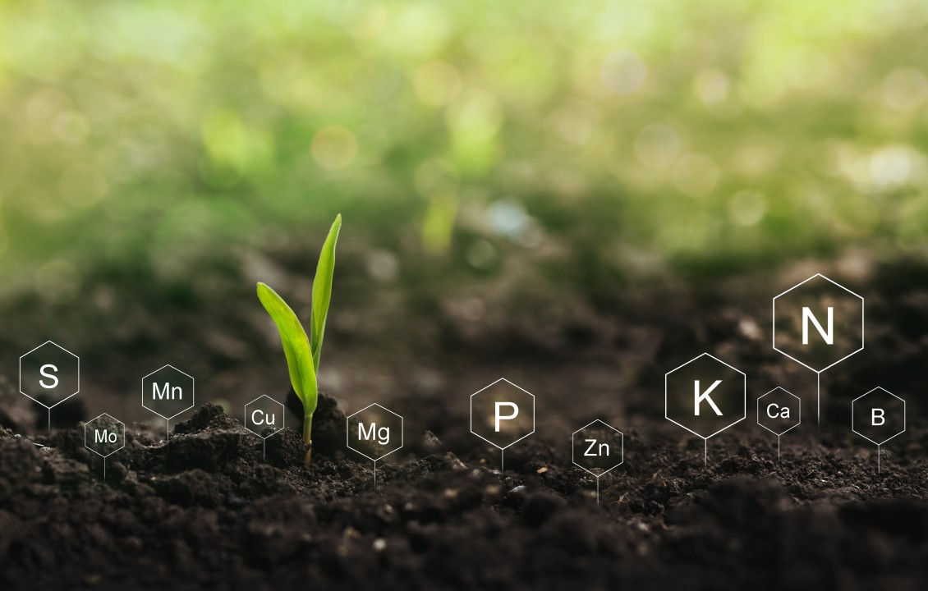

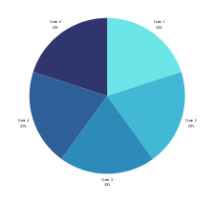
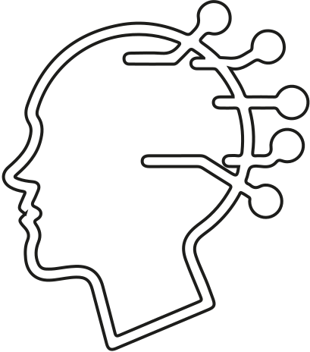



MODULE INFORMATION
CNN
VGG-16
VGG-19
Data
Tailored architecture designed specifically for bone x-ray analysis.
Incorporates multiple convolutional and pooling layers for feature extraction.
Includes fully connected layers for classification, with dropout regularization to prevent overfitting.
Utilizes pre-trained VGG-16 architecture as a feature extractor.
Consists of 16 convolutional layers followed by max pooling and fully connected layers.
Incorporates transfer learning by fine-tuning the pre-trained model for bone x-ray analysis.
Based on the pre-trained VGG-19 architecture, featuring 19 layers.
Leverages deep convolutional networks for feature extraction.
Utilizes transfer learning to adapt the model to bone x-ray analysis, with fine-tuning of parameters.
Data Collection
Data Loading
Data Preprocessing
Data augumentation.

Slide 8

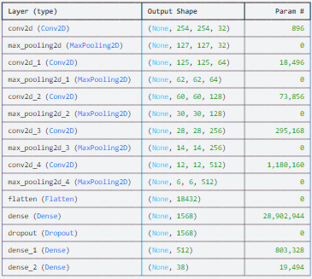
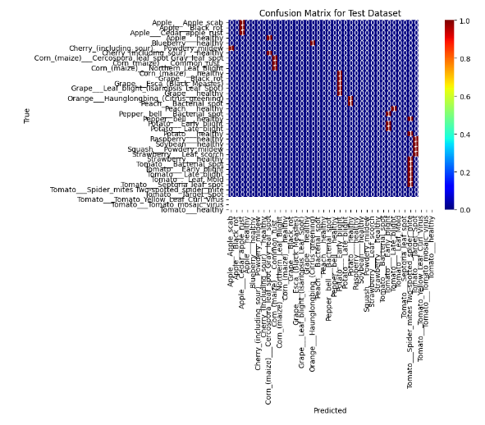
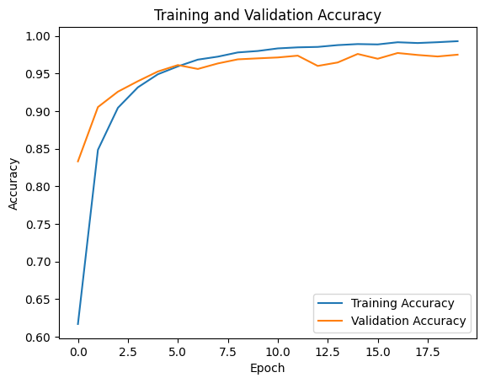
CNN RESULTS

Slide 9
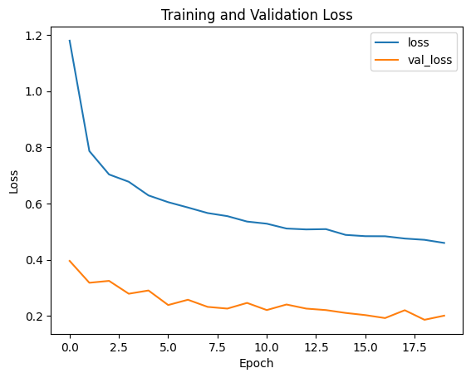
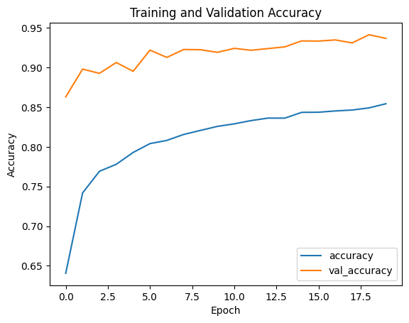
VGG-16 RESULTS

Slide 10
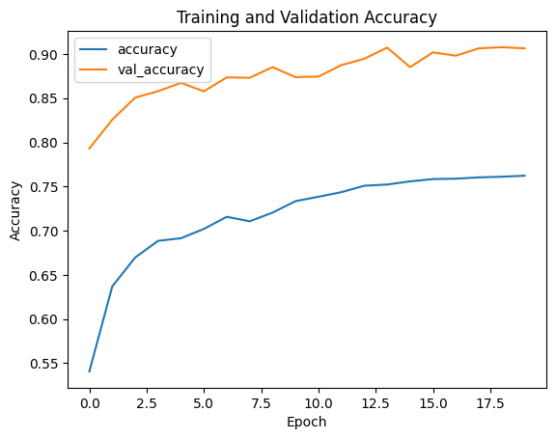
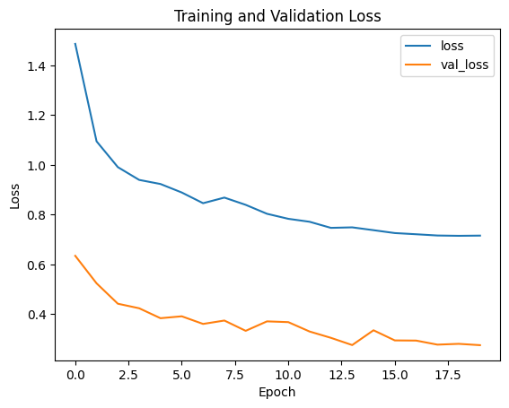
VGG-19 RESULTS

Slide 11

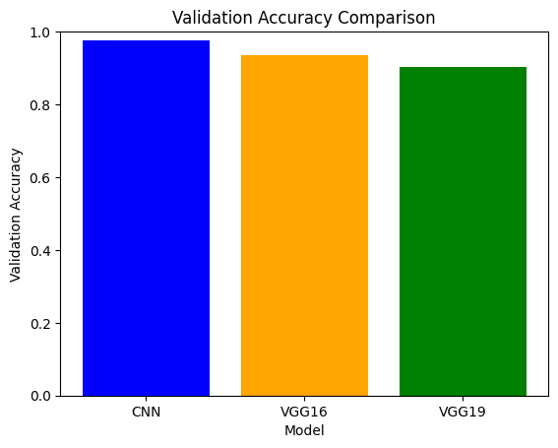
Conclusion and Future
Moreover, we envision deploying the classifier as a user-friendly application accessible to farmers and researchers. This application could leverage mobile or web-based platforms to enable real-time diagnosis of plant nutrient deficiency in the field, empowering users to make informed decisions and take proactive measures to optimize crop health and productivity.
In conclusion, our project represents a significant step forward in leveraging deep learning for addressing agricultural challenges, particularly in diagnosing plant nutrient deficiency. Through meticulous data preprocessing, thoughtful model design, and rigorous training and evaluation, we have developed a robust classifier capable of accurately identifying nutrient deficiencies in plants based on leaf images.
By harnessing the power of artificial intelligence and machine learning, we have the potential to revolutionize agricultural practices and contribute to global efforts towards sustainable food production. We are excited about the possibilities that lie ahead and remain committed to advancing the field of precision agriculture for the betterment of society.

Slide 12
THANK YOU

